Slide 1
User Guide
Minimum Sample Size calculator

Slide 2
Introduction :
Welcome to our web app that helps you calculate the minimum sample size required for your website experimentation. This user guide will walk you through the steps needed to use our tool effectively.

Slide 3
Parameters:
Our web app takes into account four main parameters: baseline conversion rate, number of variations, minimum detectable effect, and percent of users to be involved in the experiment.
Baseline Conversion Rate:
The baseline conversion rate is the current conversion rate of your website. This is the rate at which visitors to your website are performing the desired action (e.g., making a purchase, signing up for a newsletter).
Number of Variations:
The number of variations refers to the number of different versions of your website that you plan to test. For example, you may want to test a new headline, a different color scheme, or a different layout.
Minimum Detectable Effect:
The minimum detectable effect is the smallest change in conversion rate that you are interested in detecting. This is typically expressed as a percentage.
Percent of Users to be Involved in the Experiment:
The percent of users to be involved in the experiment is the percentage of visitors to your website that will be included in the experiment. This is typically expressed as a percentage.
Calculations:
Once you have entered your parameters into the web app, it will calculate the minimum sample size required for your website experimentation. The sample size is calculated based on statistical principles and takes into account the variability in your data.

Slide 4



Slide 5
Enter your desired values for the input parameters given to obtain the result required
Note:
Avoid values, such that “Start event count” < “End event count”
Either enter “Start even count” and “End event count” or “Baseline conversion percent”, not both together
“Minimum detectable effect” is a optional parameter. When entered, the output is given only for the specified MDE but, a range of MDE is used for calculated when “Minimum detectable effect” is left empty.
Alpha and beta are set to 0.05 and 0.80 by default according to the business standards. This could be modified, if required by the user.

Slide 6
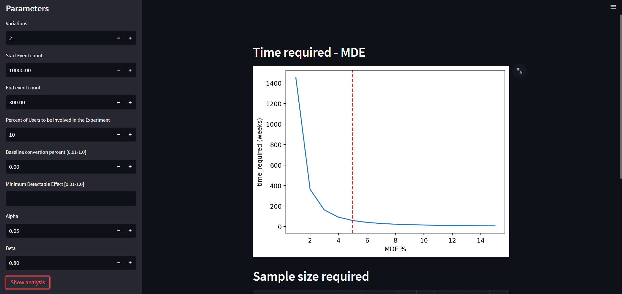
Example Output :

Slide 7
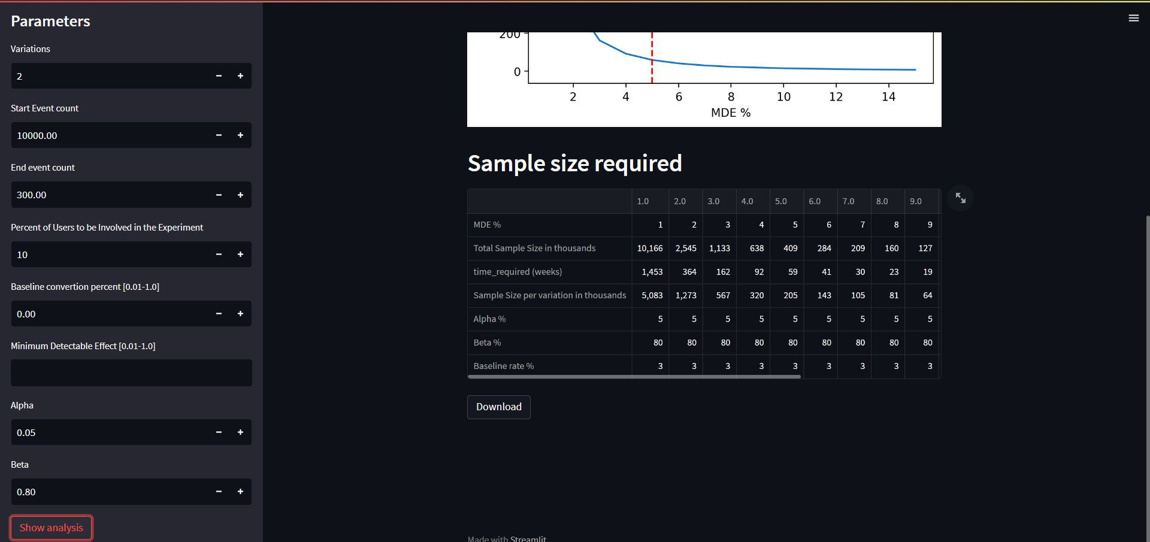
Example Output :

Slide 8
Conclusion:
Using our web app can help you make informed decisions about your website variations. By calculating the minimum sample size required for your experiment, you can ensure that you have enough data to make statistically significant decisions.

